Slide 1
Python for data analytics
Rachel asquith
Research specialist, office of program decision support
Texas Department of state health services

Slide 2
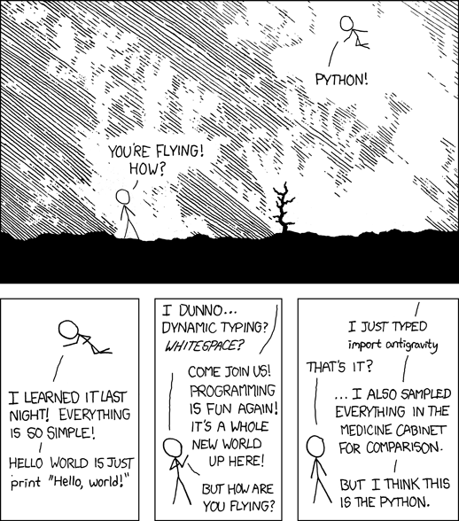
Why Python?
Free, transparent, open-source
Huge community and growing
Good at everything
Clear and readable code
Relatively easy to learn
xkcd.com

Slide 3
The advantages of open source
Upgrades, packages, etc. are all completely free and can be downloaded by anyone
Open source provides users with a risk-free choice
Open source packages are constantly evolving/ improving—you don’t have to wait for a release
Transparency offers the ability to view, edit, and customize the available code base
You can build on existing modules to make your own packages!

Slide 4
Python is popular
During the week before I wrote this slide, there were 3940 posts on Stack Overflow with the tag, “Python” (stackoverflow.com)
python.org had over 100,000 visits in September 2016 and over 1 million hits (legacy.python.org)
Austin has several professional groups that are Python specific and many that include python-focused content

Slide 5
Become one with the many
Python has a huge standard library
It’s often necessary to import modules included in the standard library
Some of my favorites:
re
urlib
json
os
datetime

Slide 6
Packages, packages, packages!
There’s also several thousand additional components in the Python Package Index (and other sources)
Some of my favorites:
Pandas
NumPy
Matplotlib

Slide 7
Install non-standard packages with pip
> python -m pip install SomePackage
Import modules in your script
import pandas as pd
import numpy as np

Slide 8
What I do with Python
Data cleaning, shaping, wrangling, etc.
Basic calculations
Automatic report generation
Processing and manipulating text
Data visualization

